Slide 1
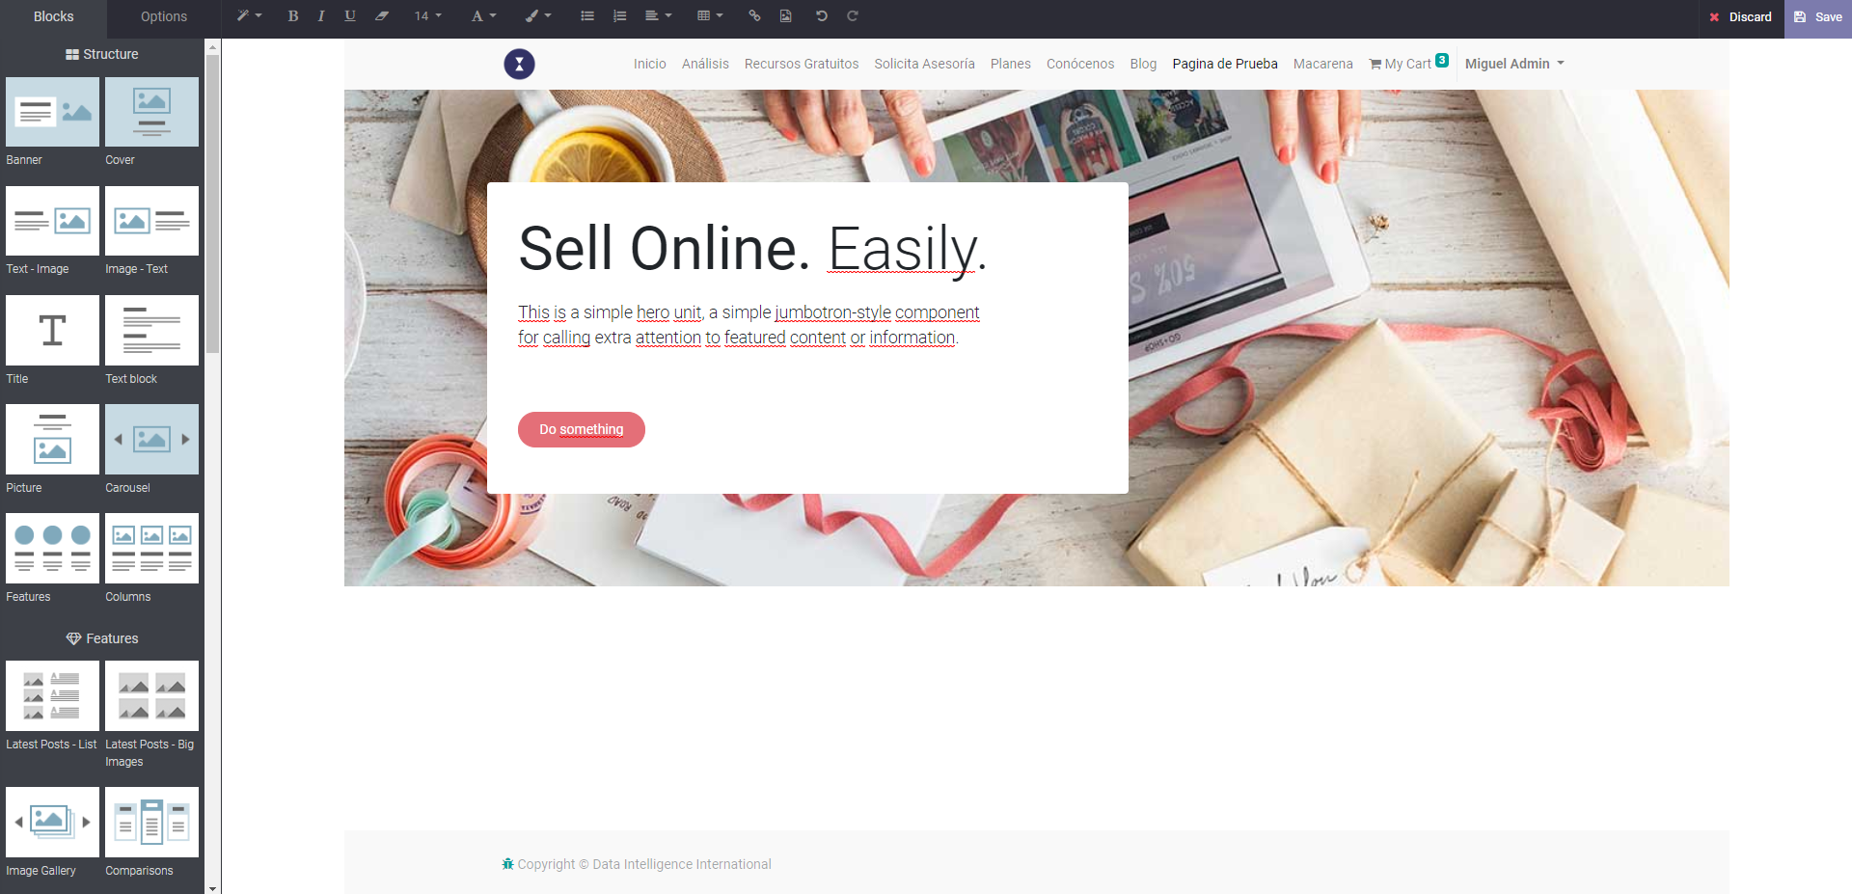
BANNER

Slide 2
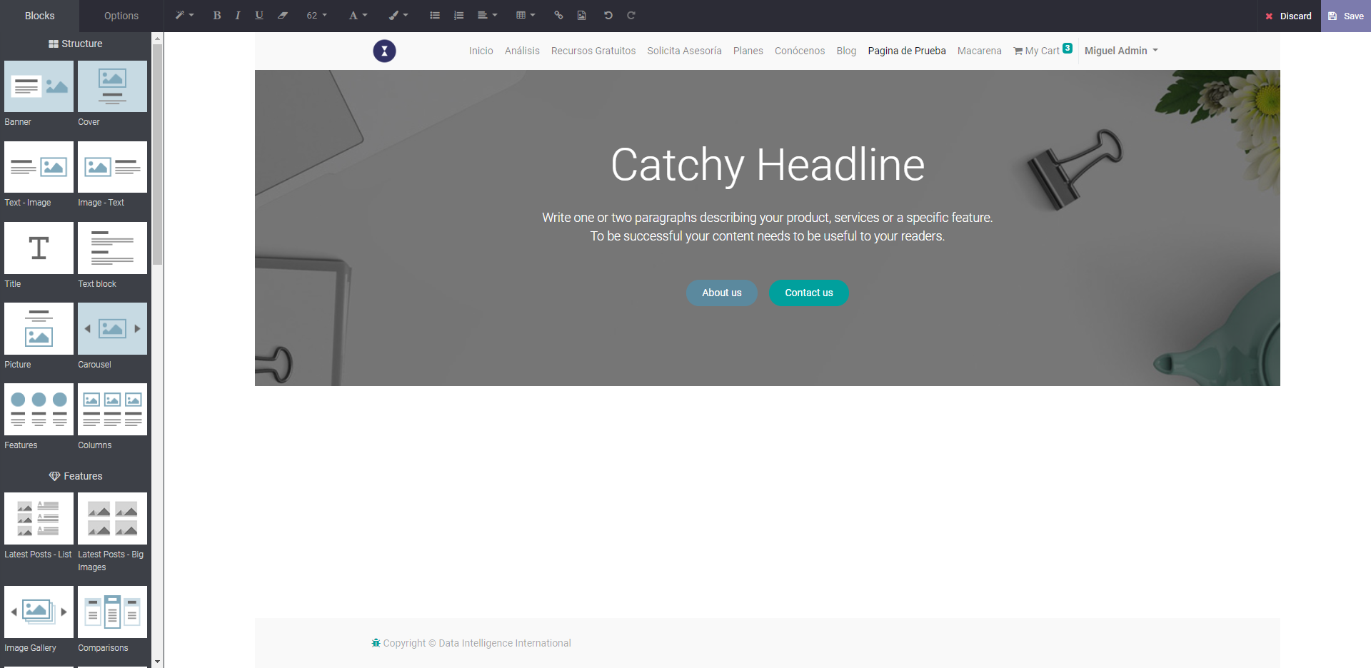
COVER

Slide 3
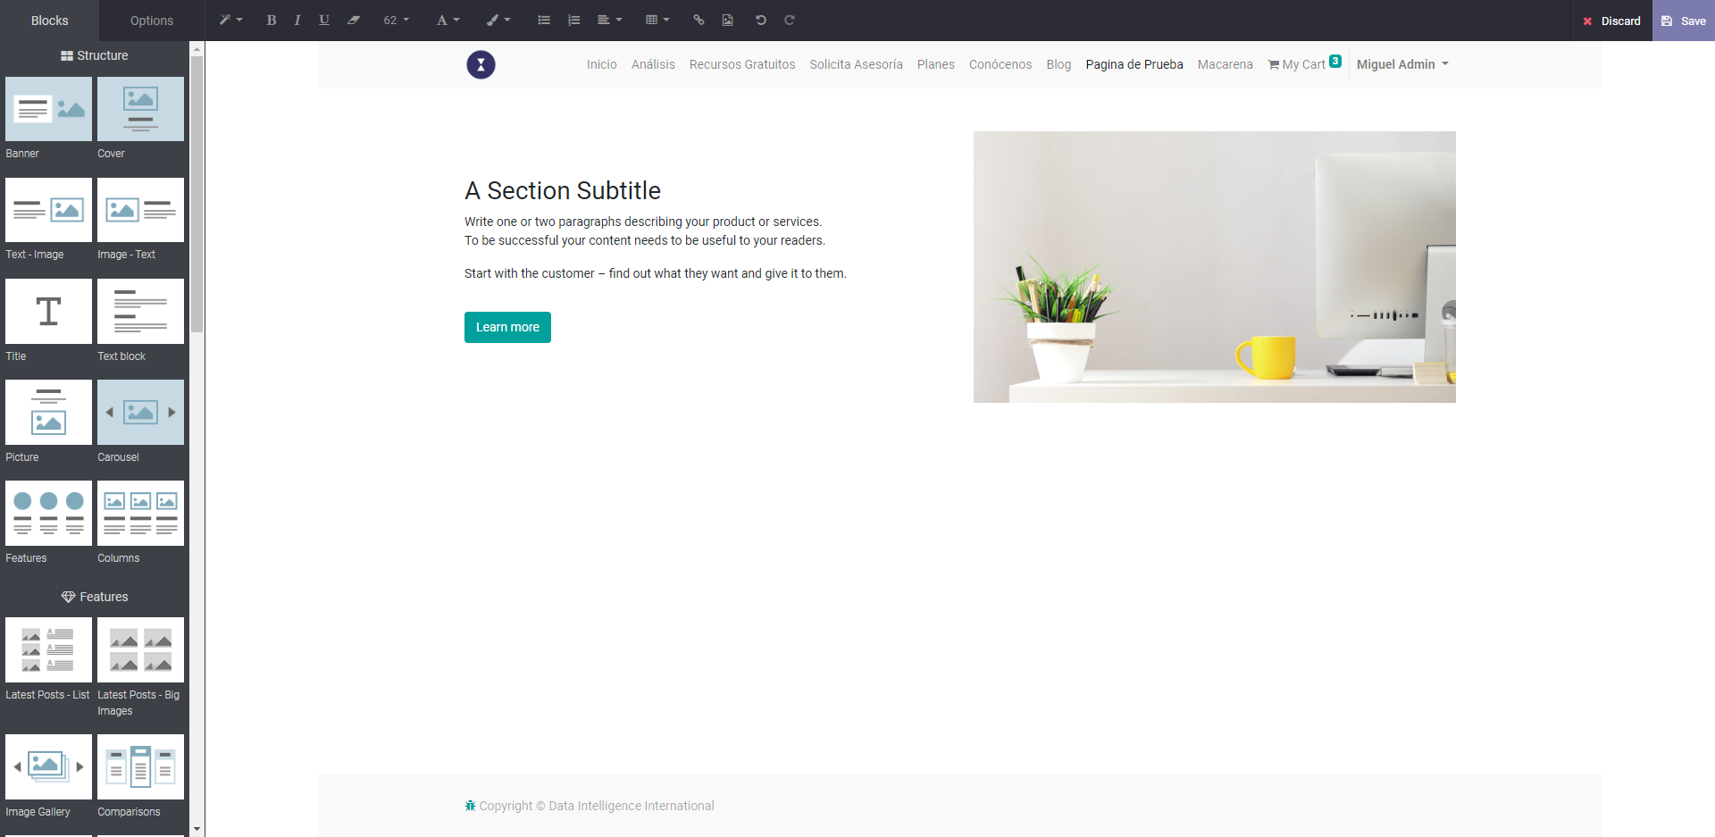
TEXT-IMAGE

Slide 4
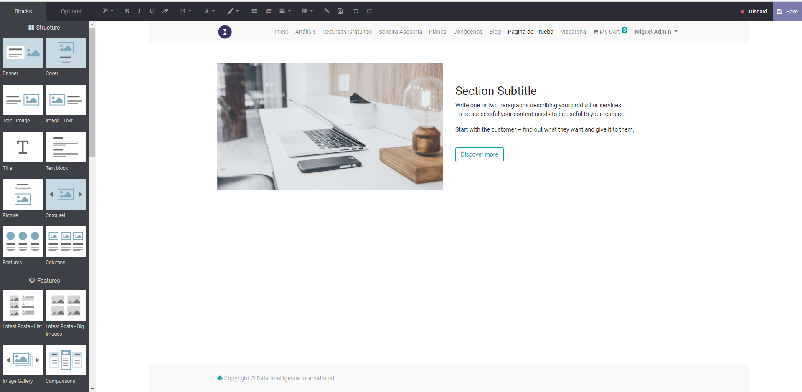
IMAGE-TEXT

Slide 5
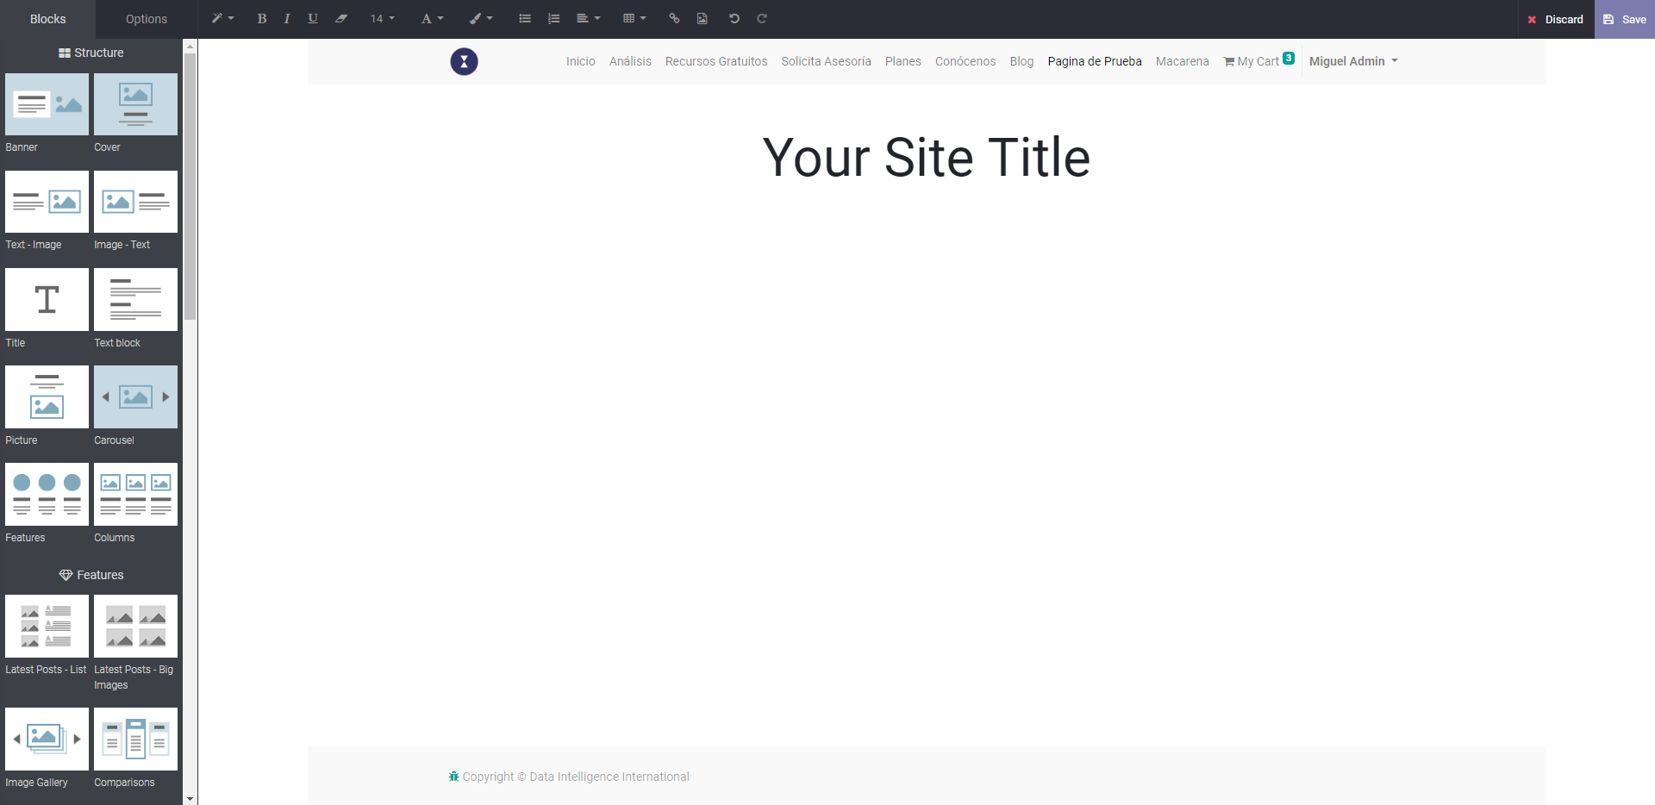
TITLE

Slide 6
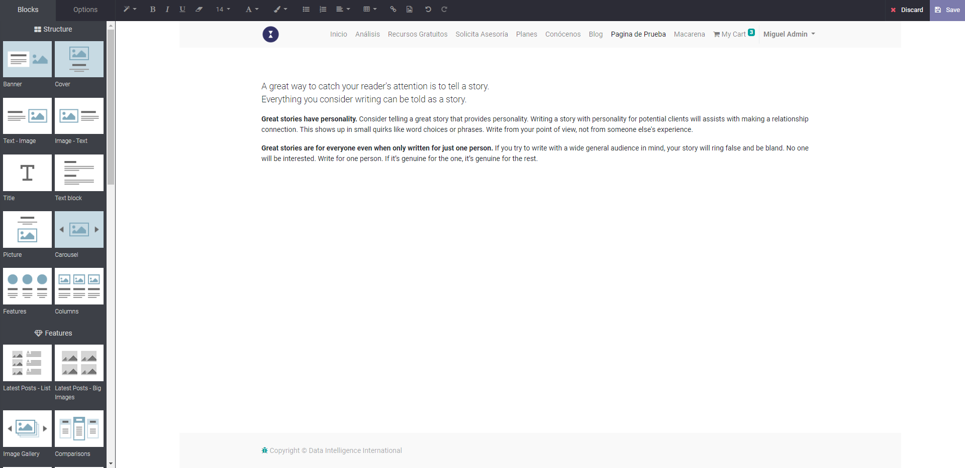
TEXT BLOCK

Slide 7
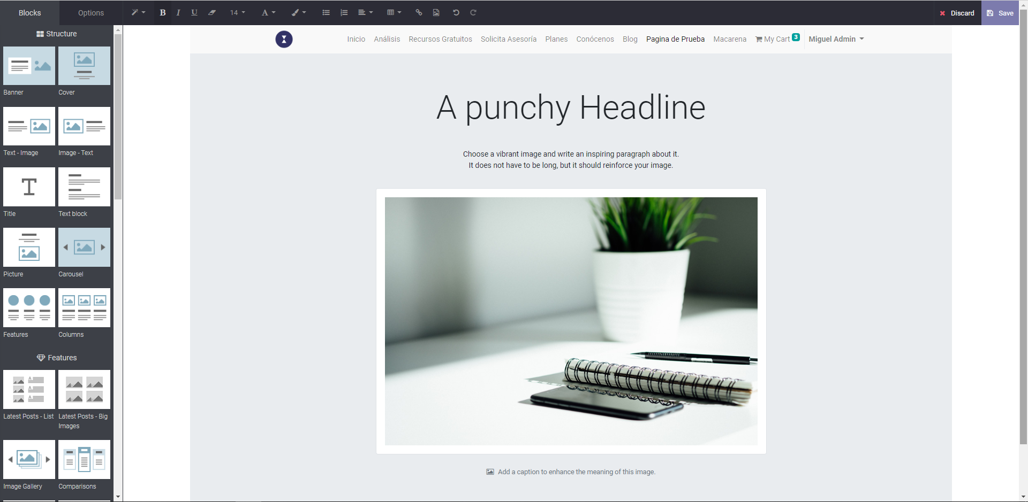
PICTURE

Slide 8
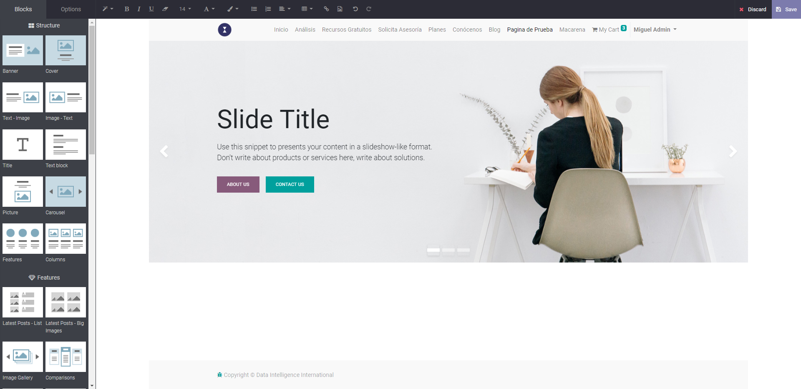
CAROUSEL

Slide 9
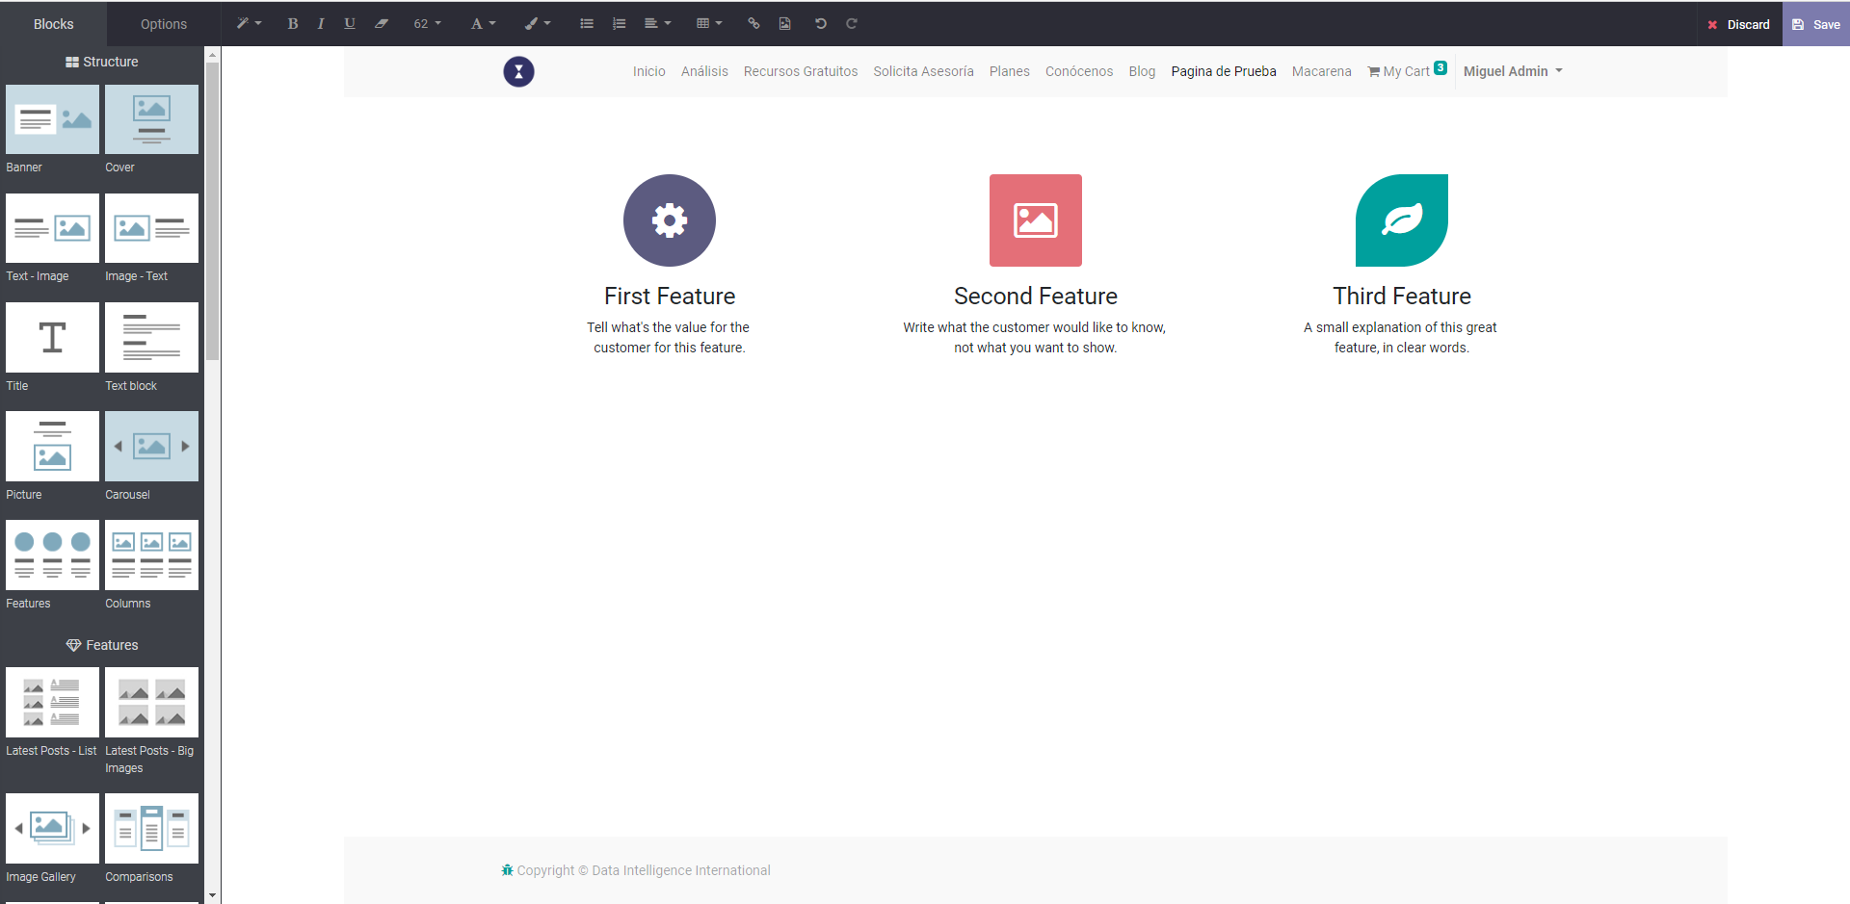
FEATURES

Slide 10
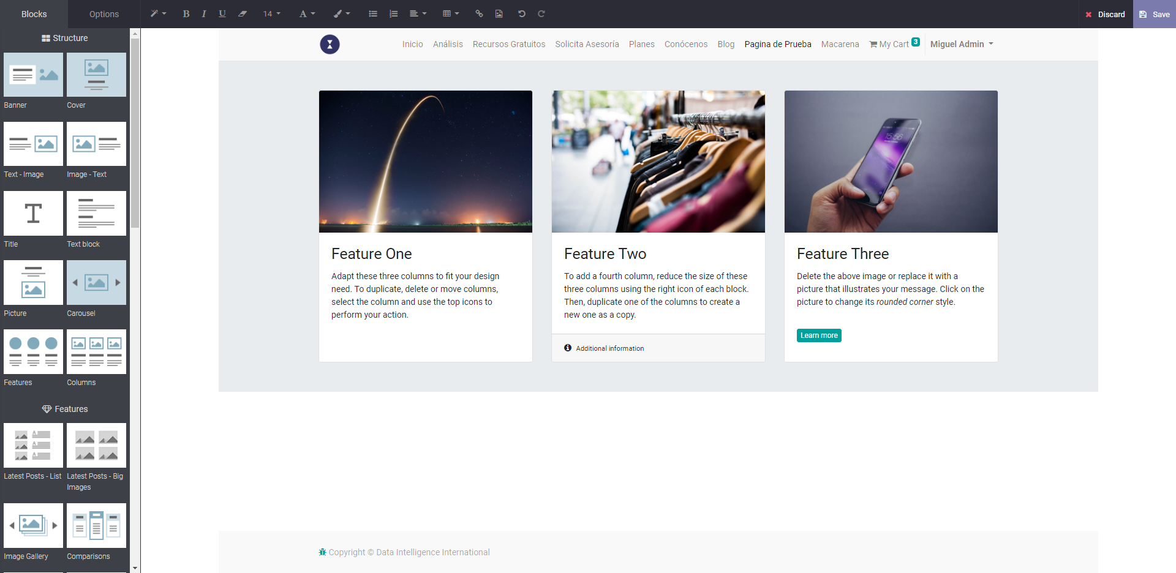
COLUMNS

Slide 11
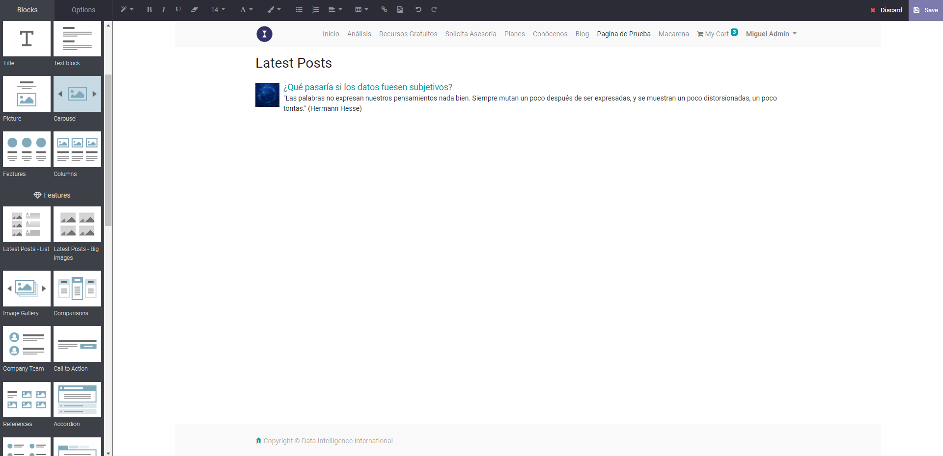
LATEST POST LIST

Slide 12
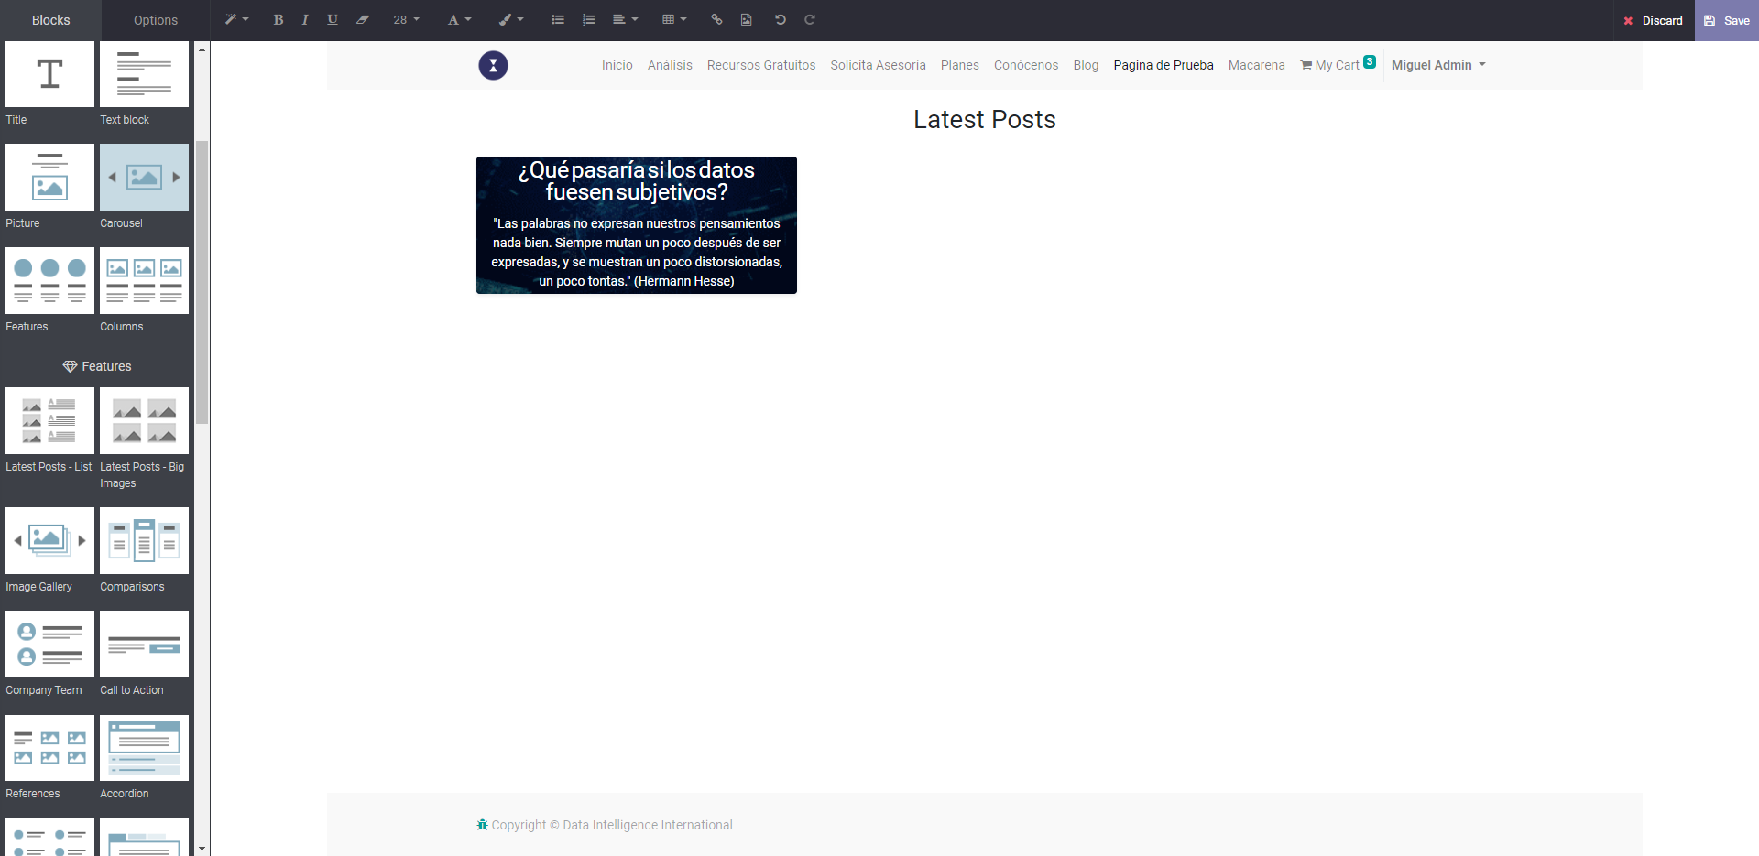
LATEST POST BIG IMAGE

Slide 13
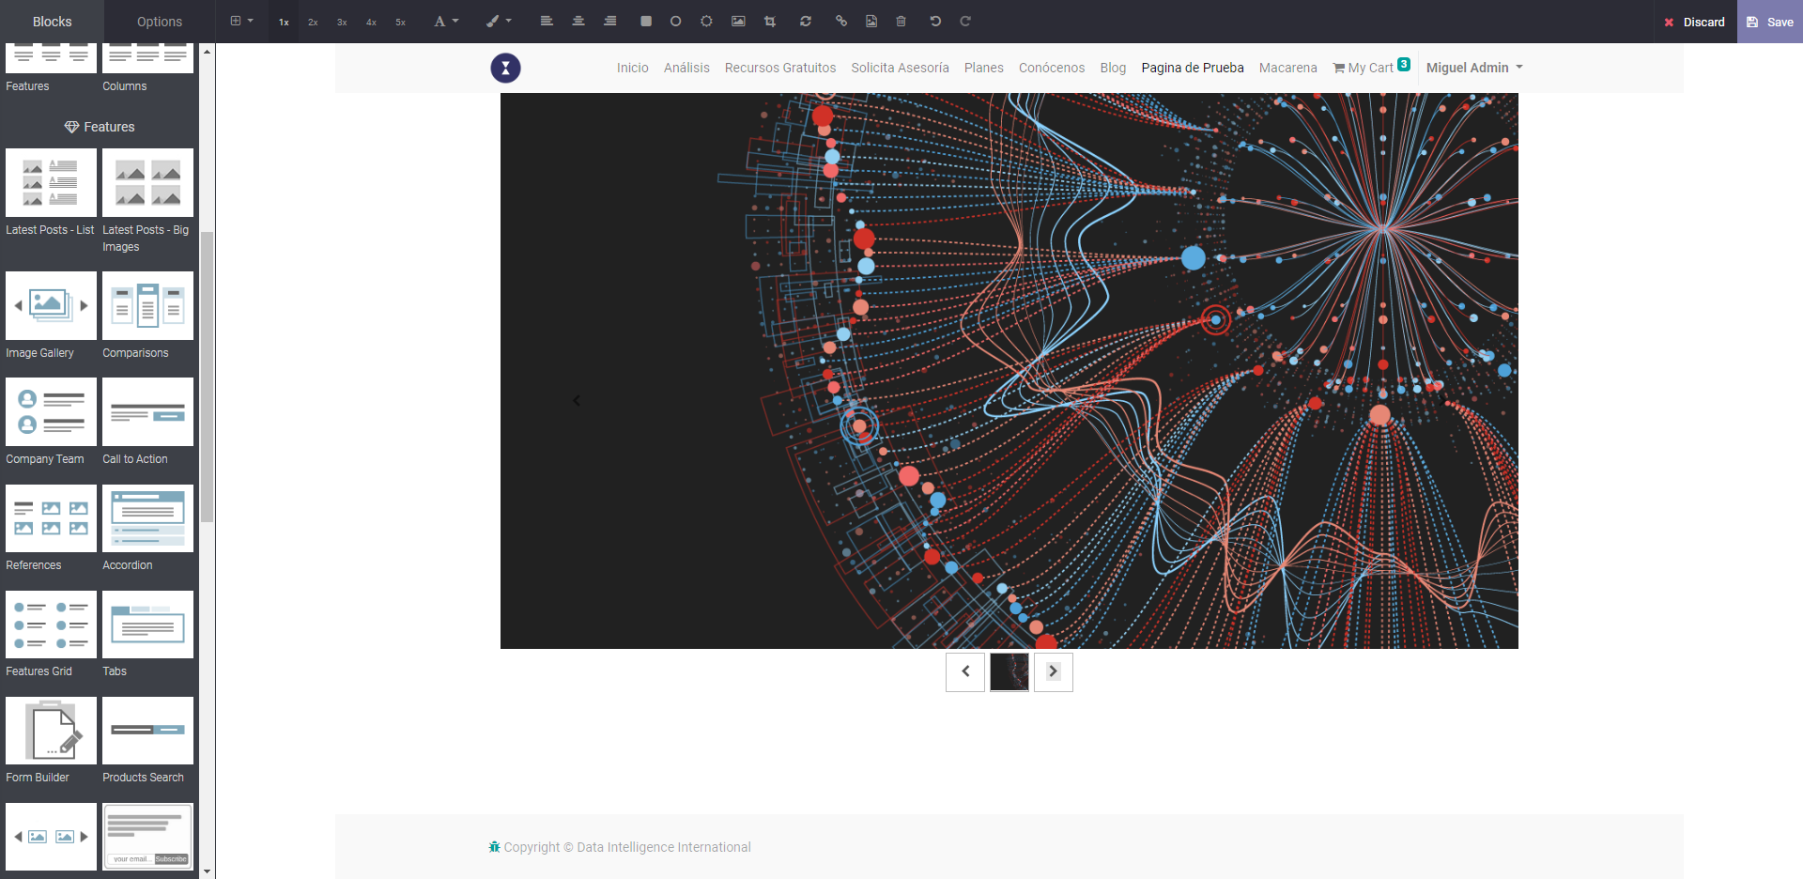
IMAGE GALLERY

Slide 14
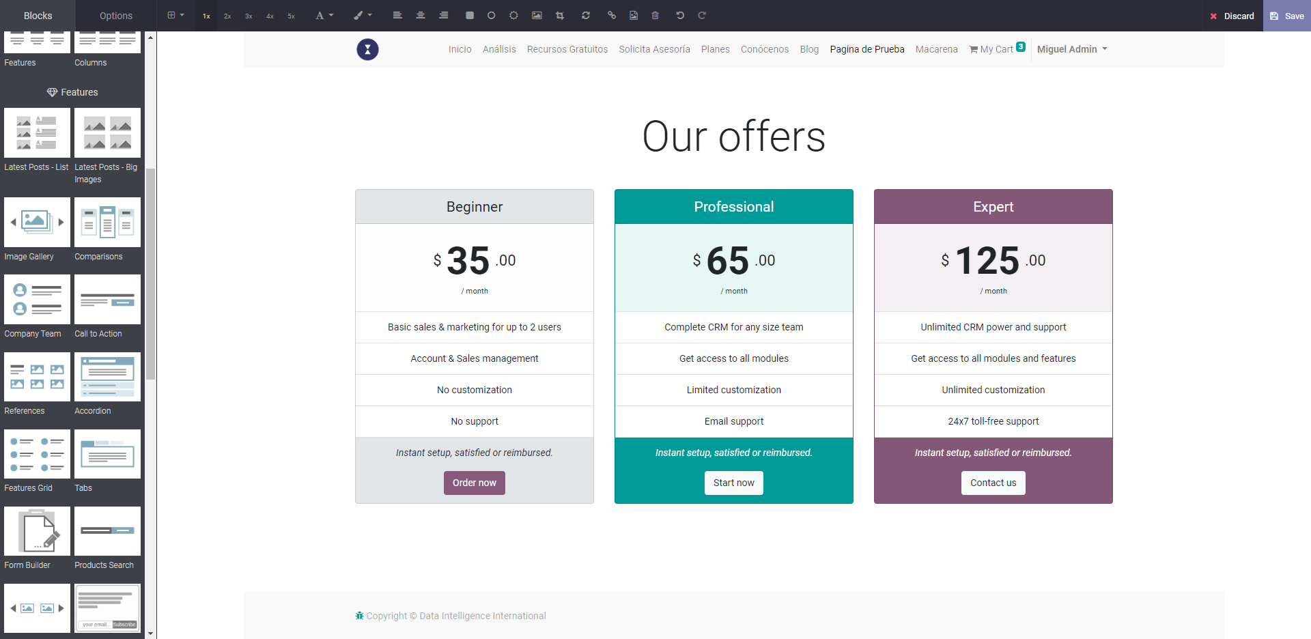
COMPARISONS

Slide 15
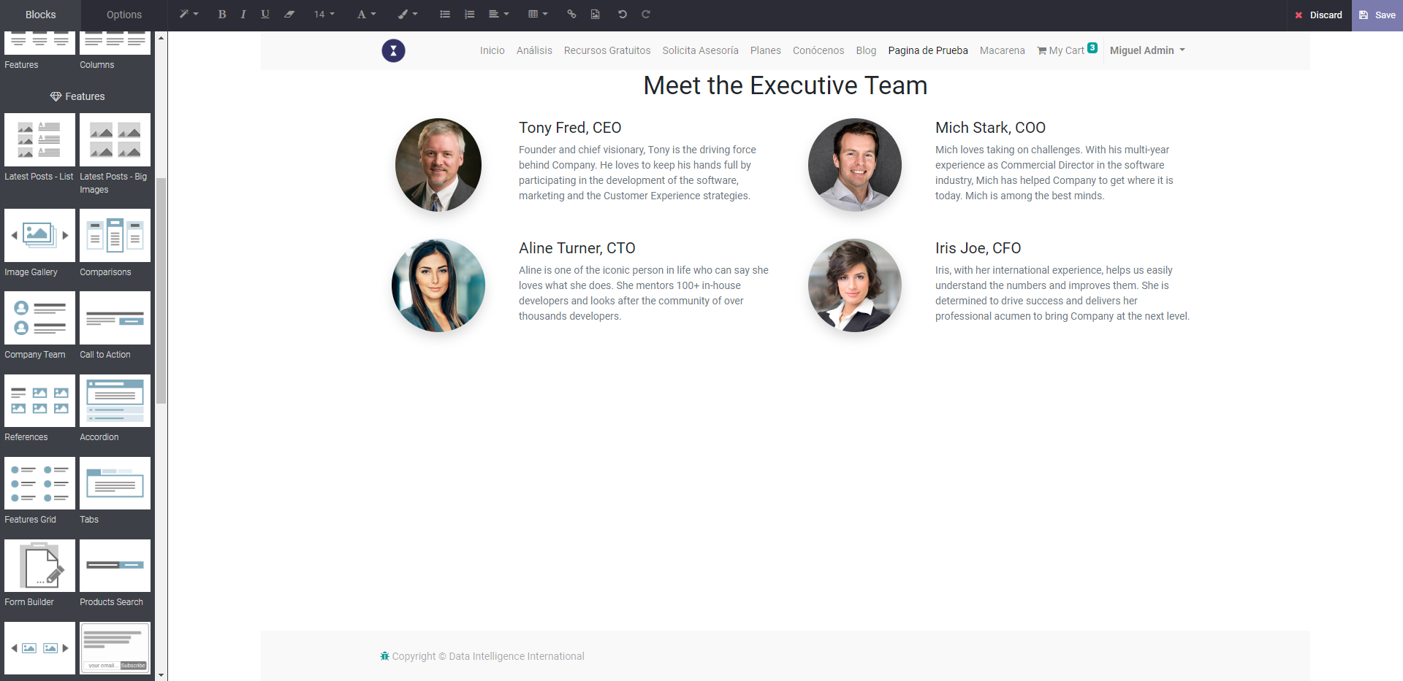
COMPANY TEAMS

Slide 16
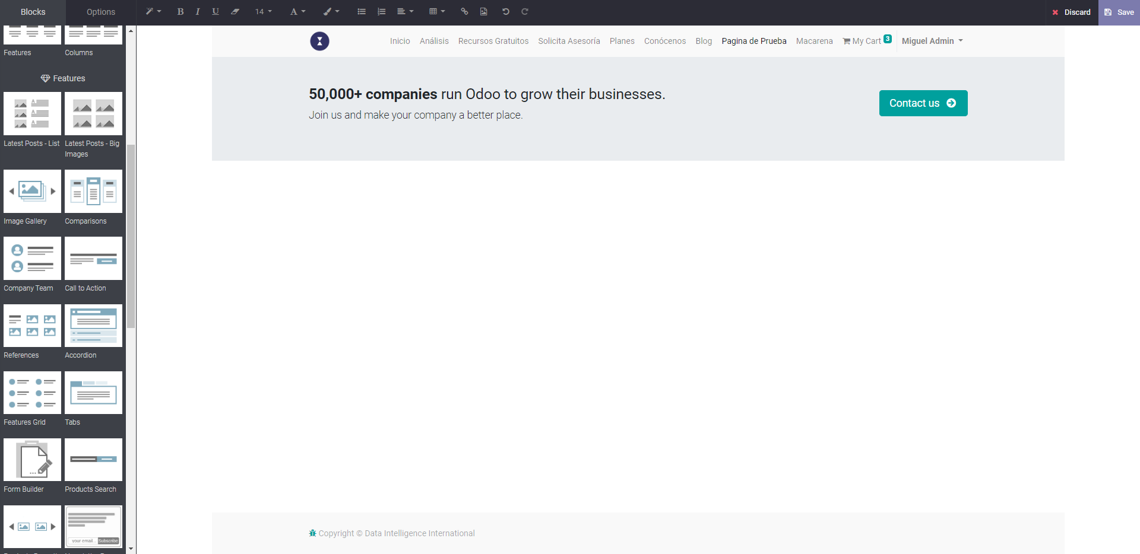
CALL TO ACTION

Slide 17
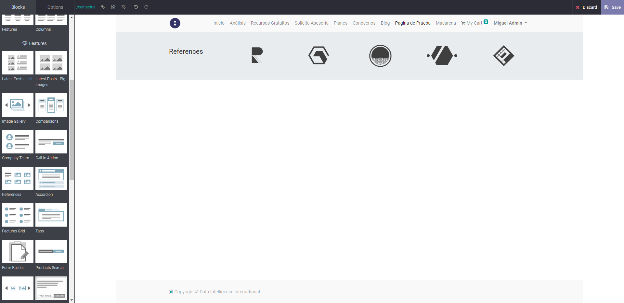
REFERENCES

Slide 18
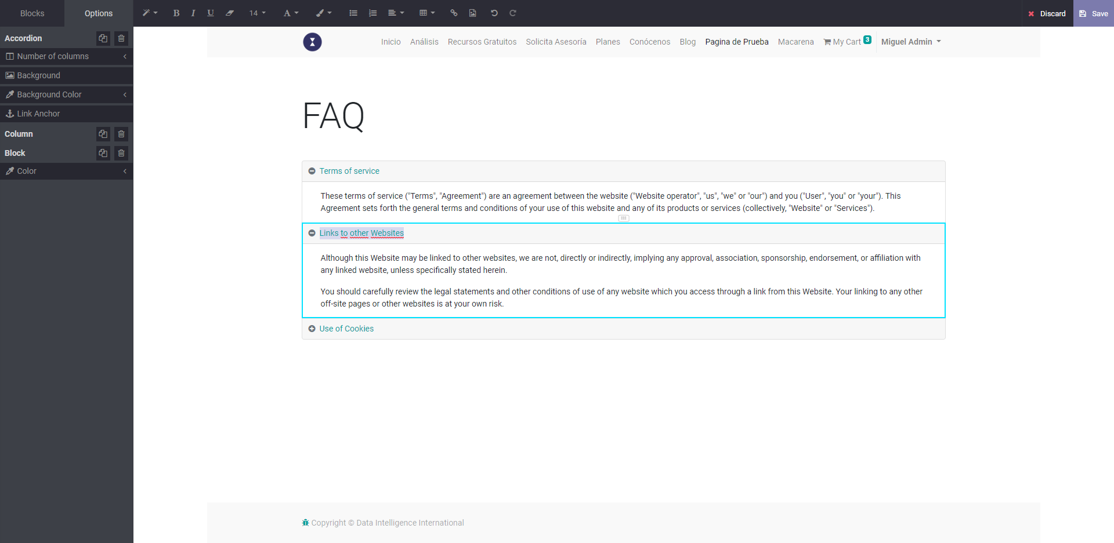
ACCORDION

Slide 19
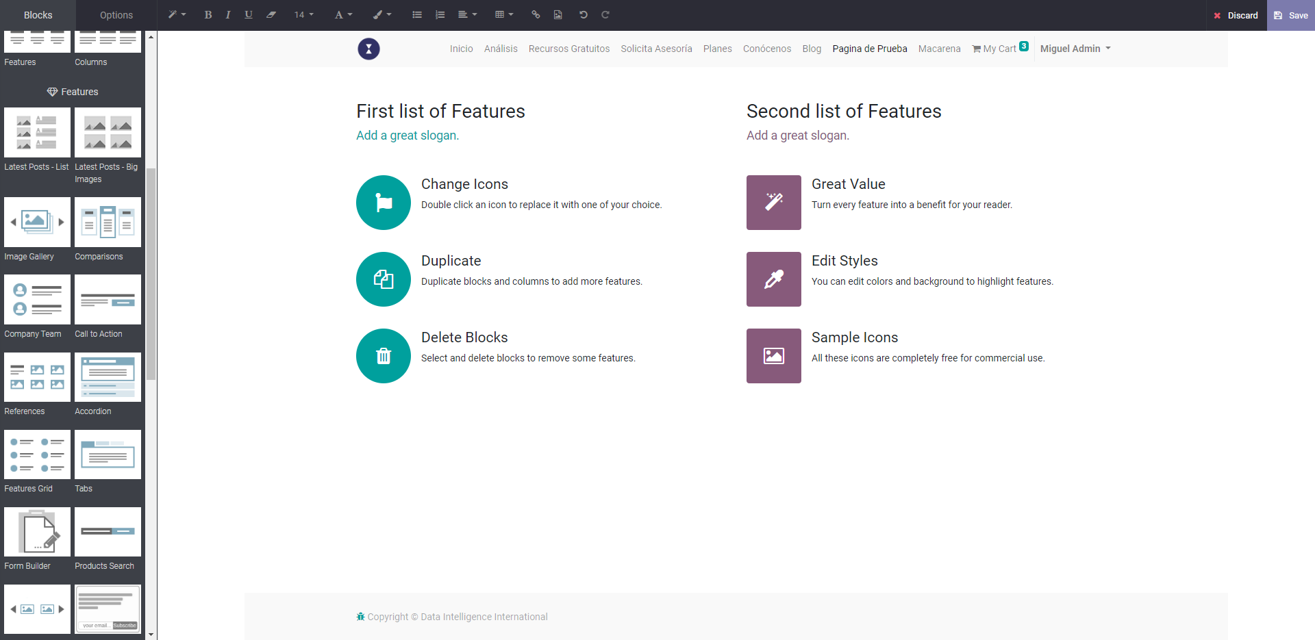
FEATURES GRID

Slide 20
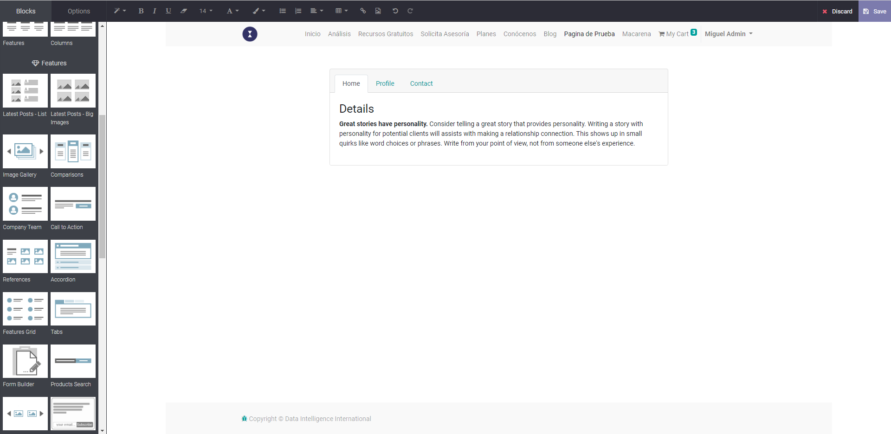
TABS

Slide 21
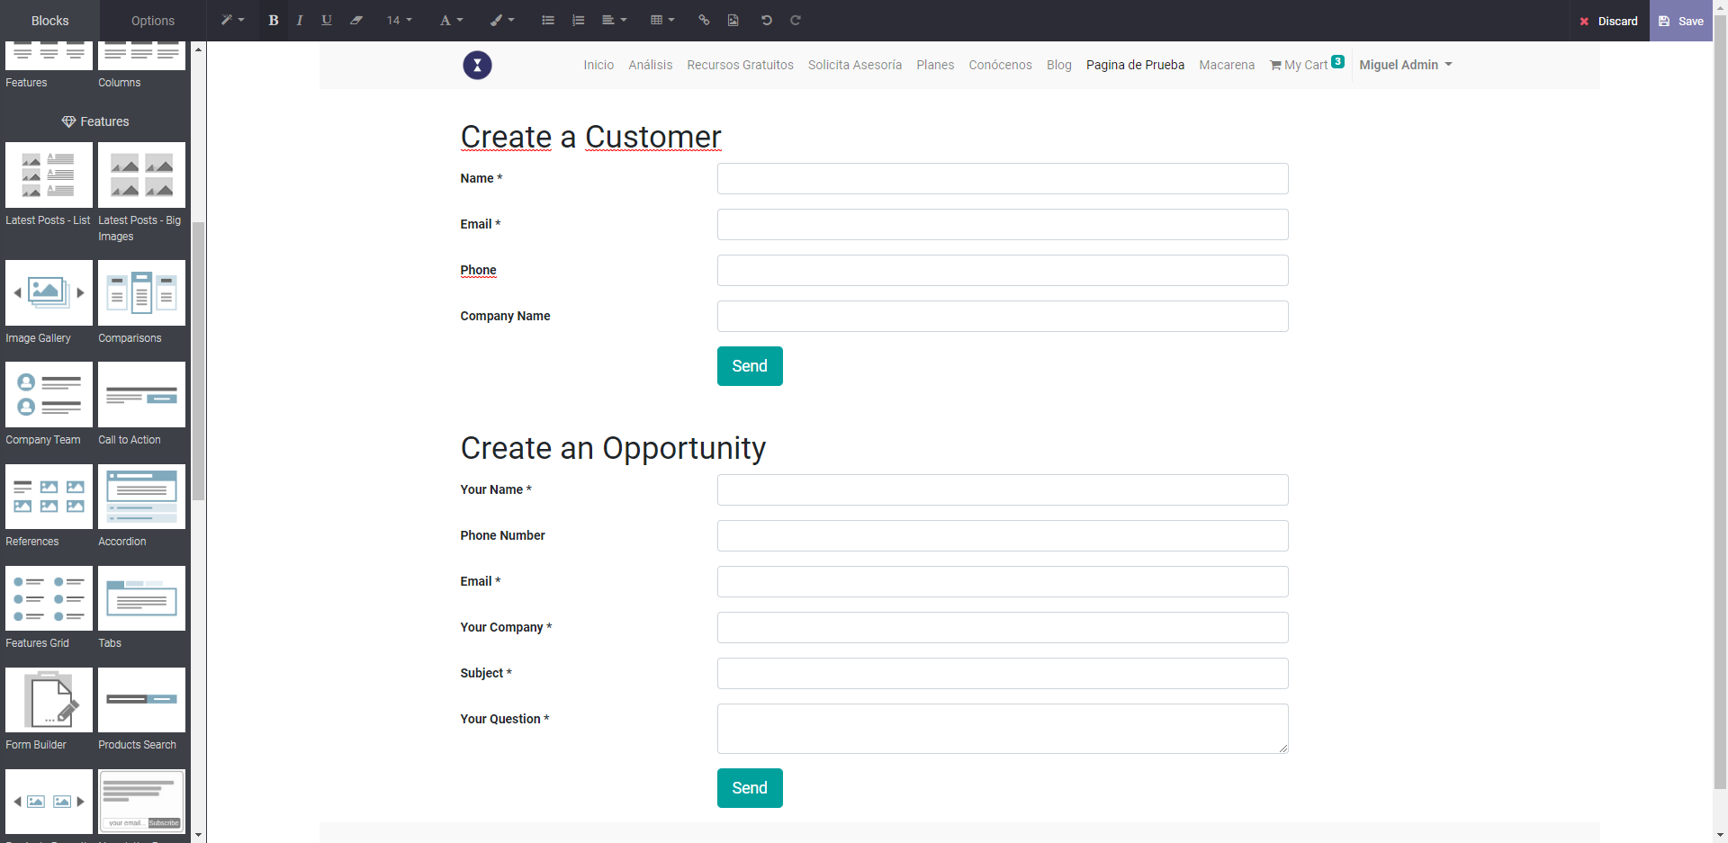
FORM BUILDER

Slide 22
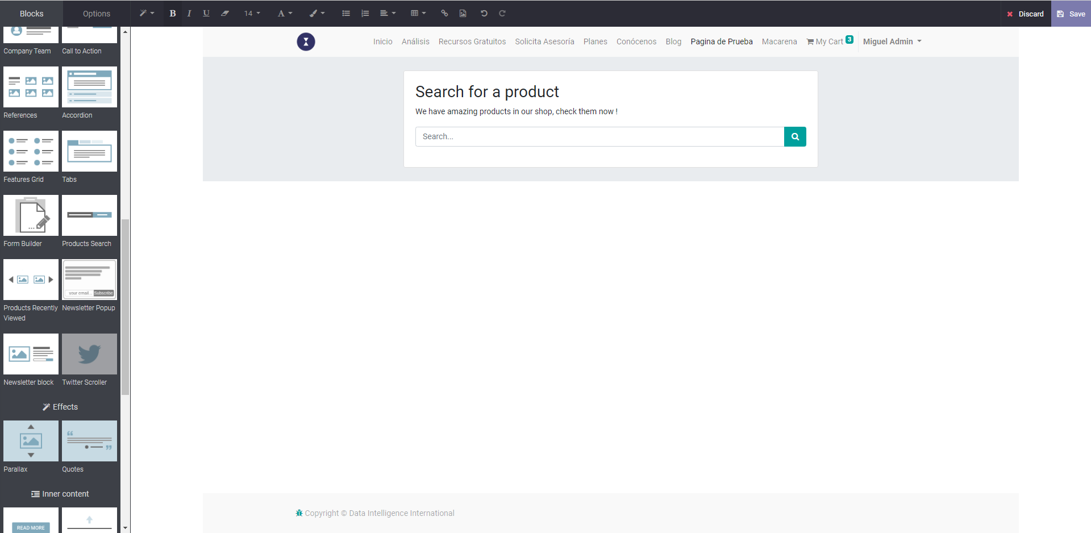
PRODUCT SEARCH

Slide 23
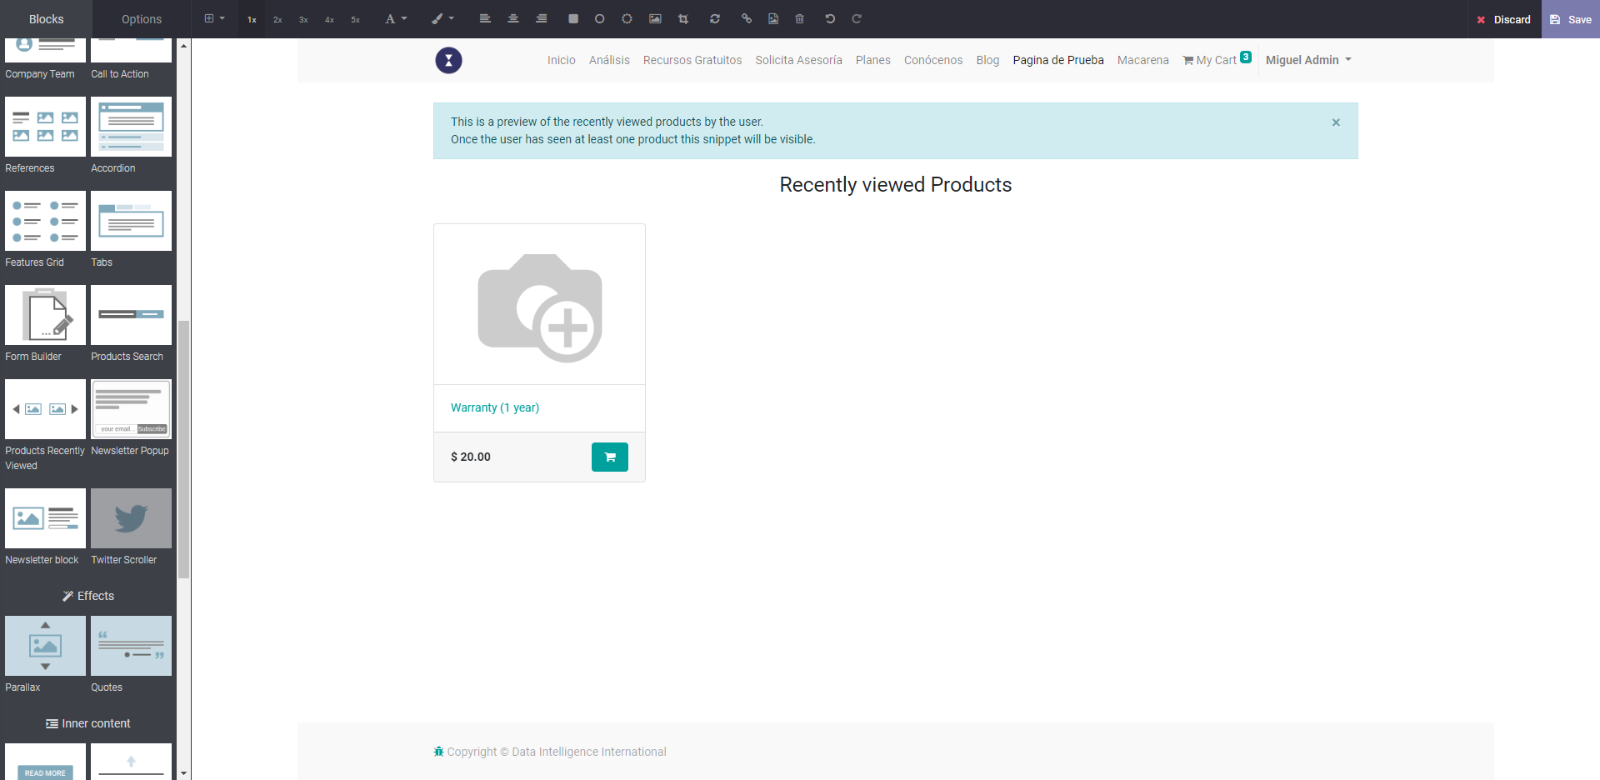
PRODUCTS RECENTLY VIEWED

Slide 24
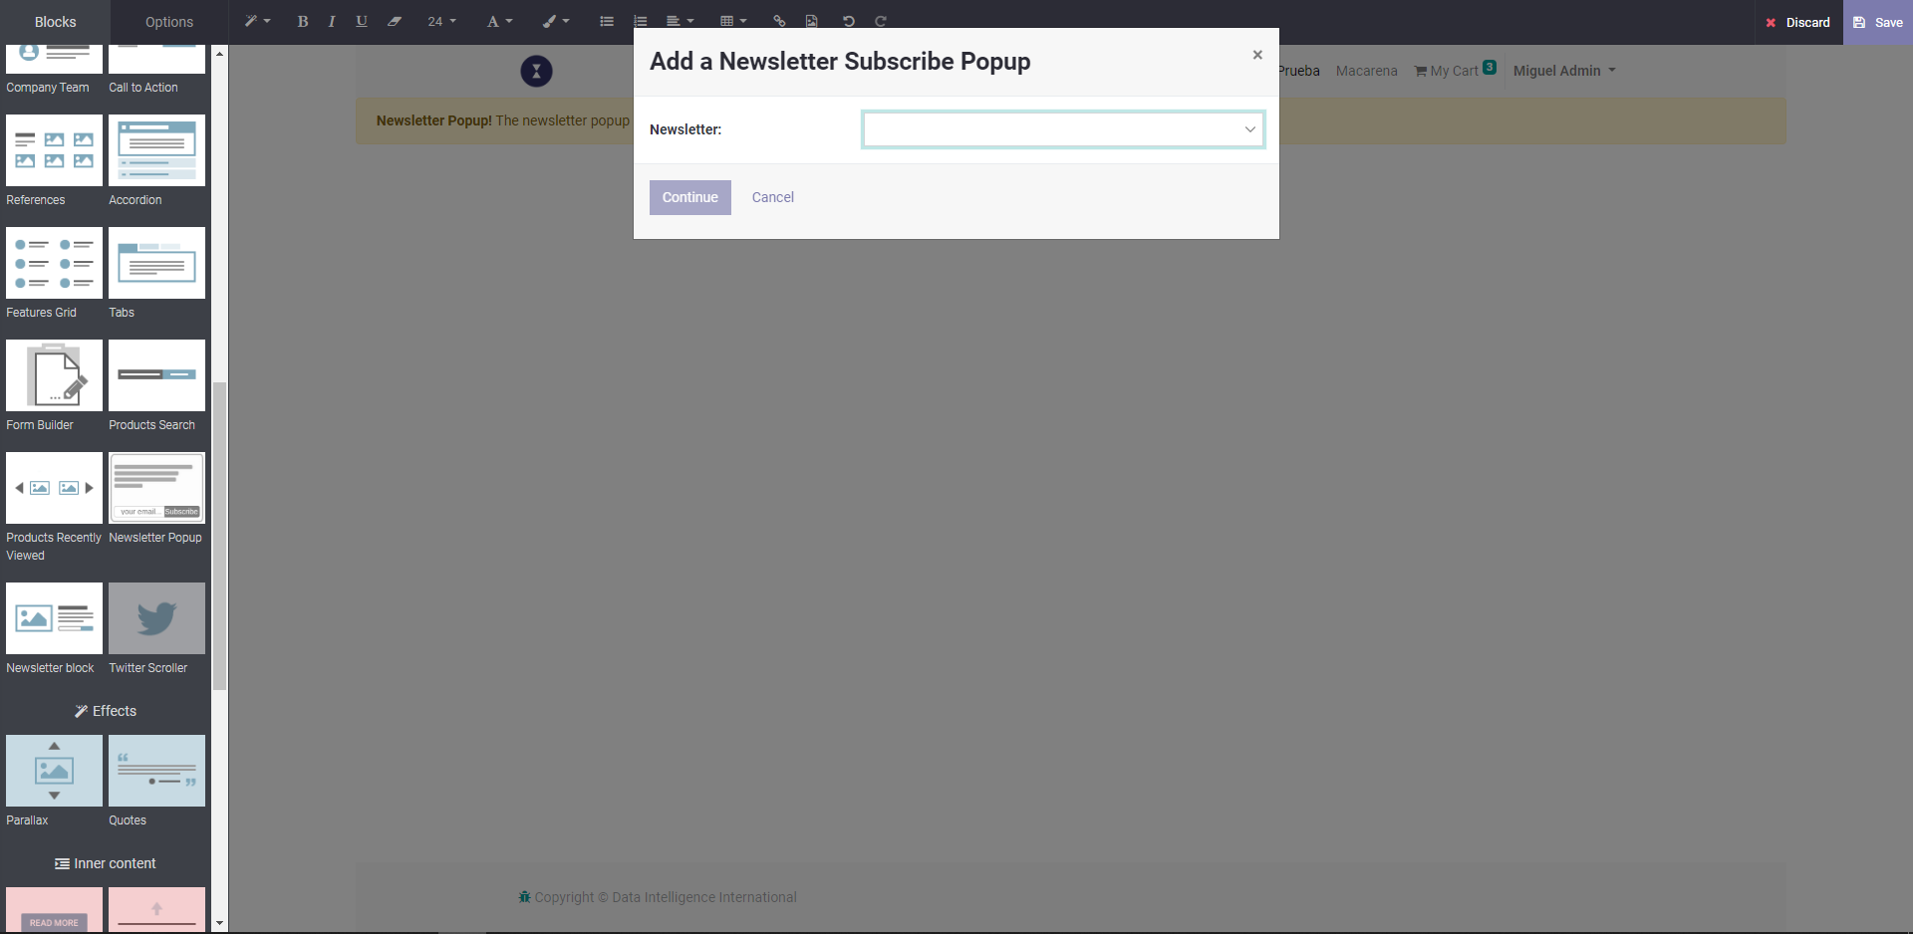
NEWSLETTER POPUP

Slide 25
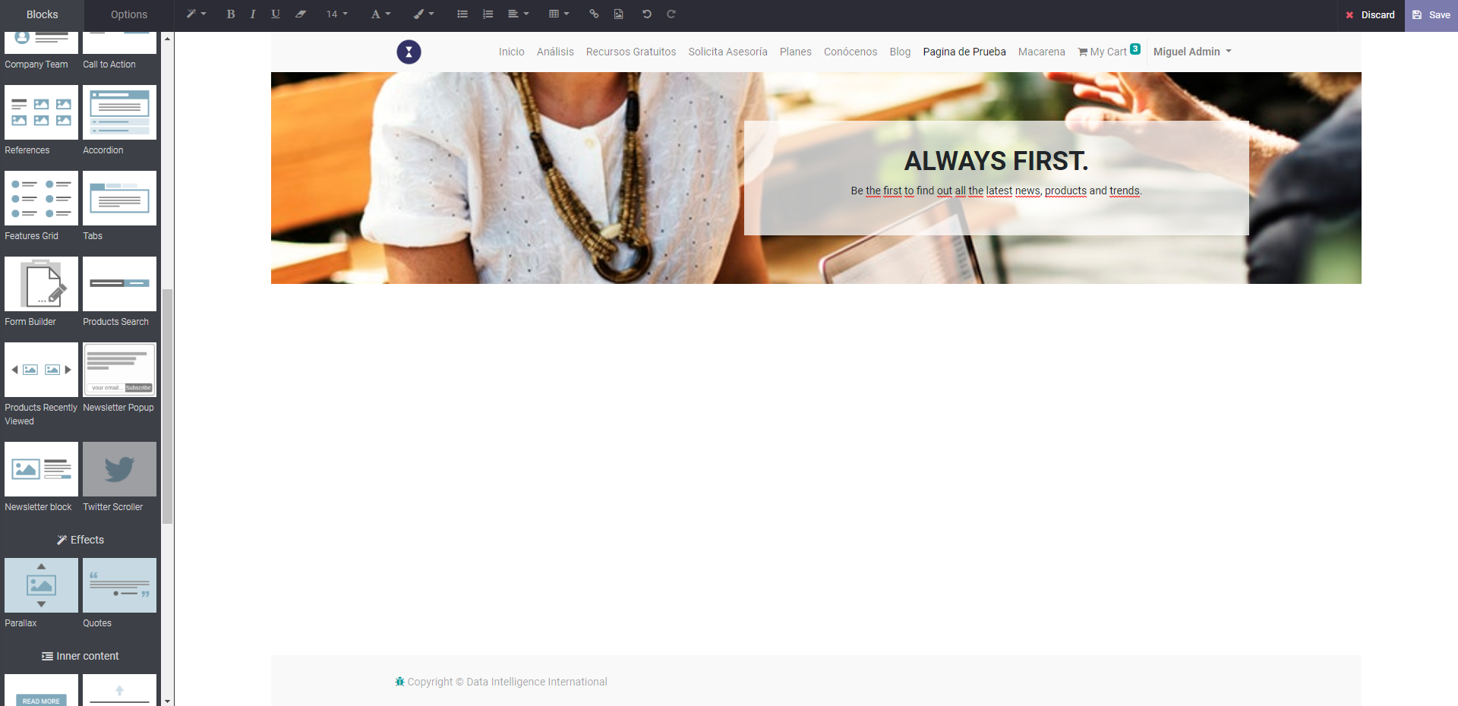
NEWSLETTER BLOCK

Slide 26
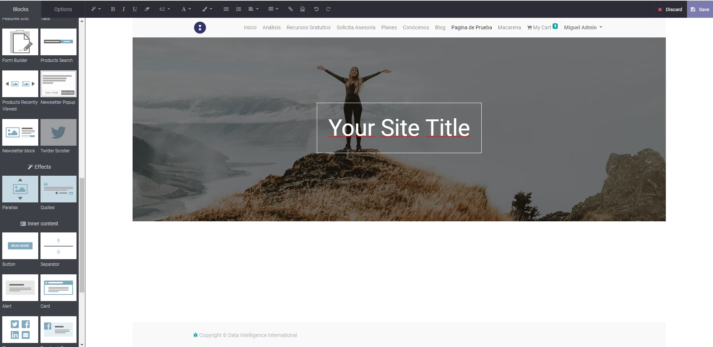
PARALLAX

Slide 27
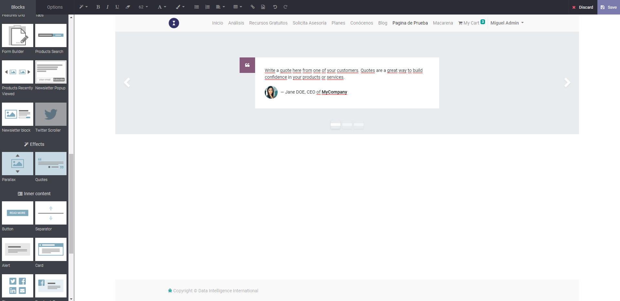
QUOTES

Slide 28
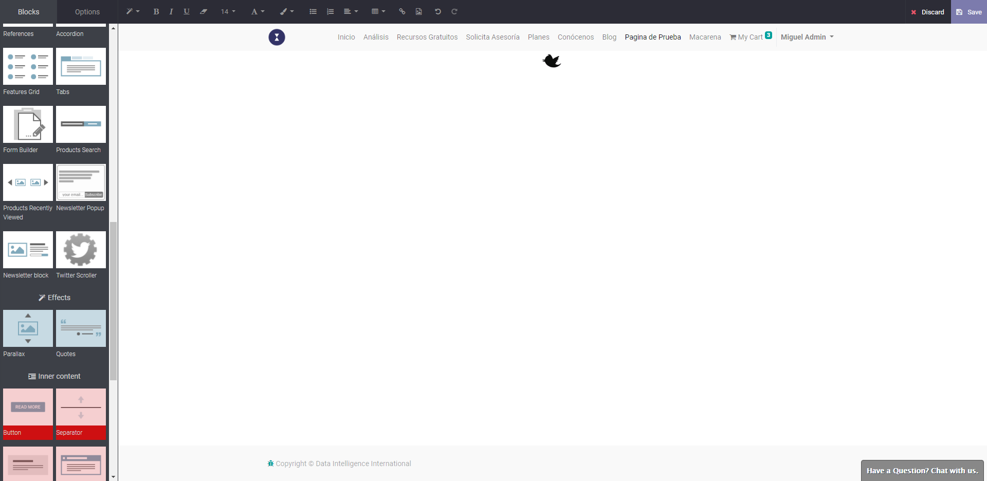
TWITTER SCROLLER

Slide 29
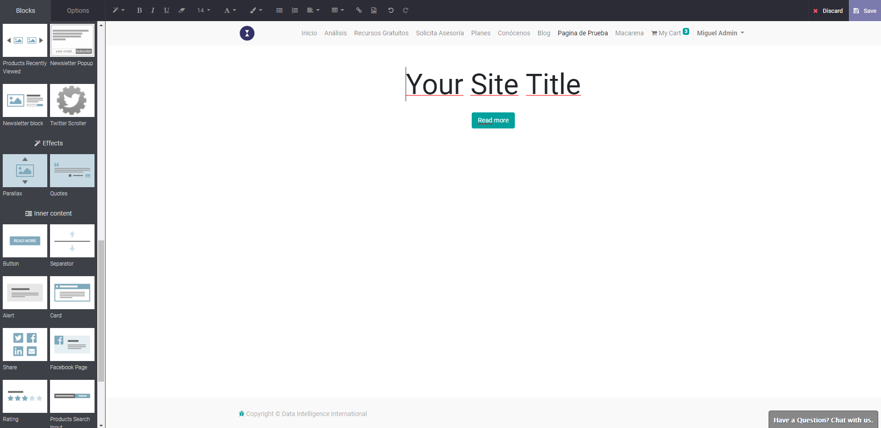
BUTTON

Slide 30
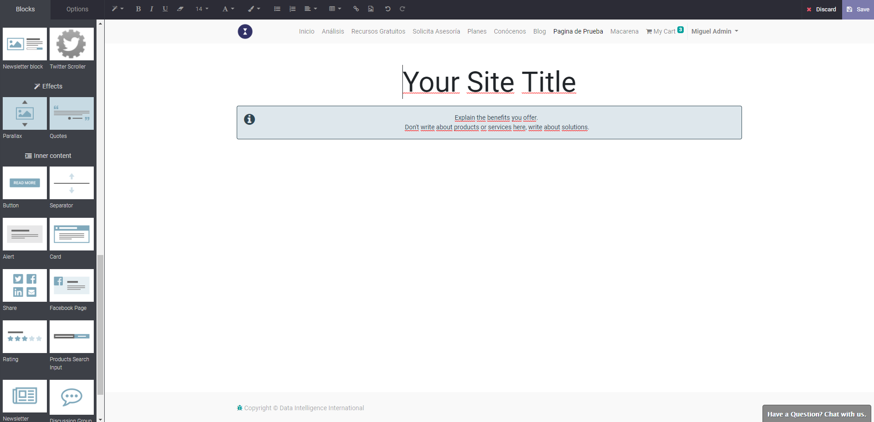
ALERT

Slide 31
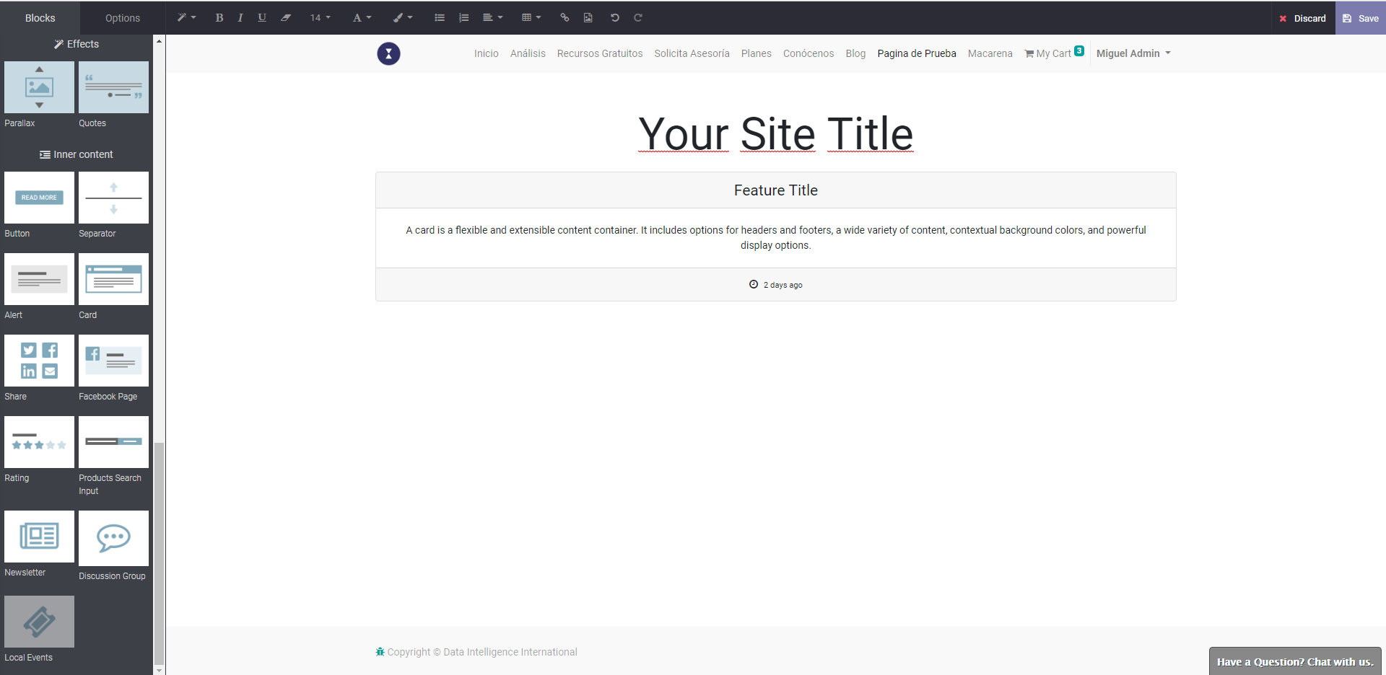
CARD

Slide 32
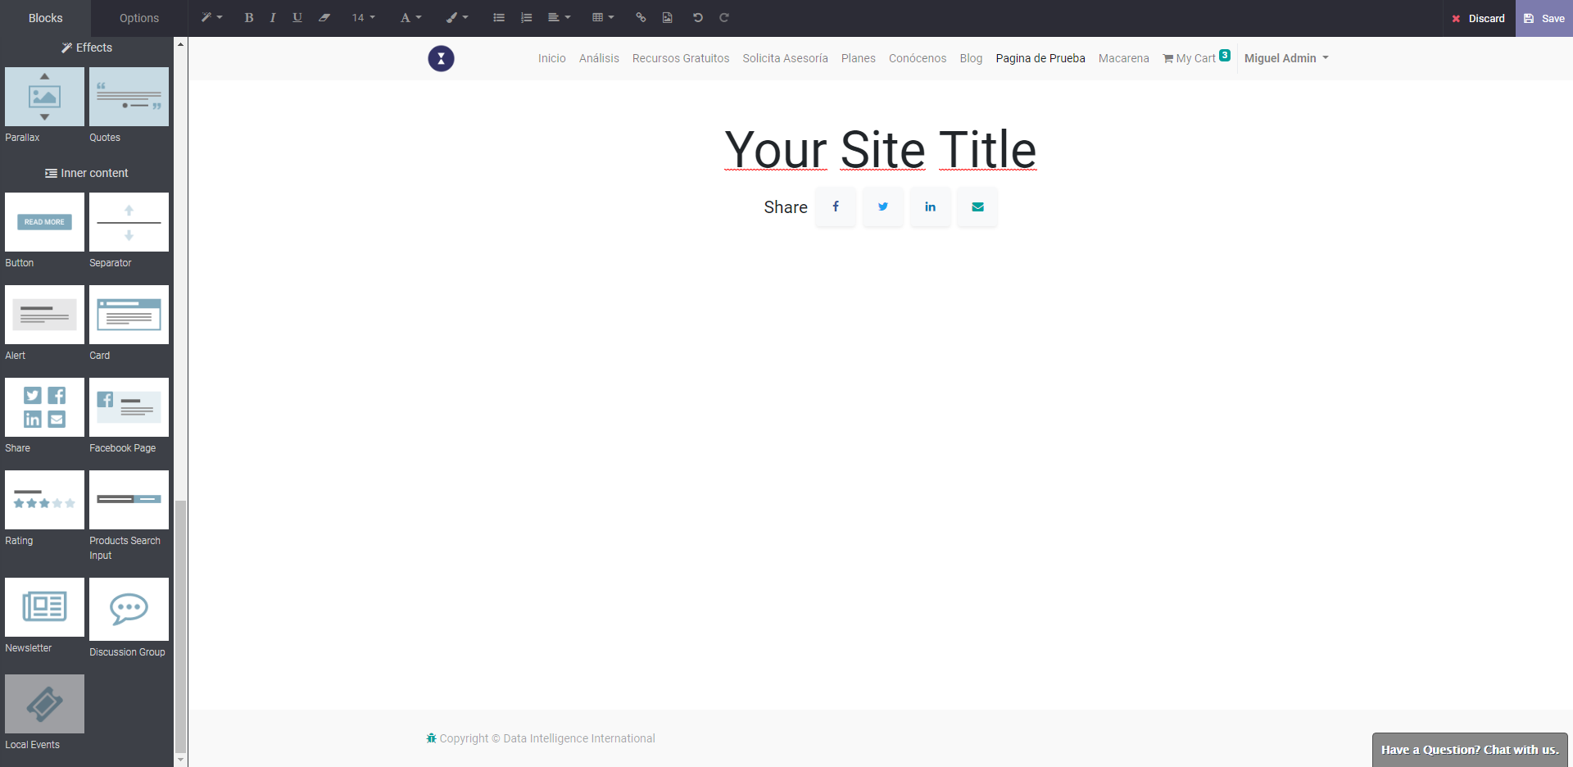
SHARE

Slide 33
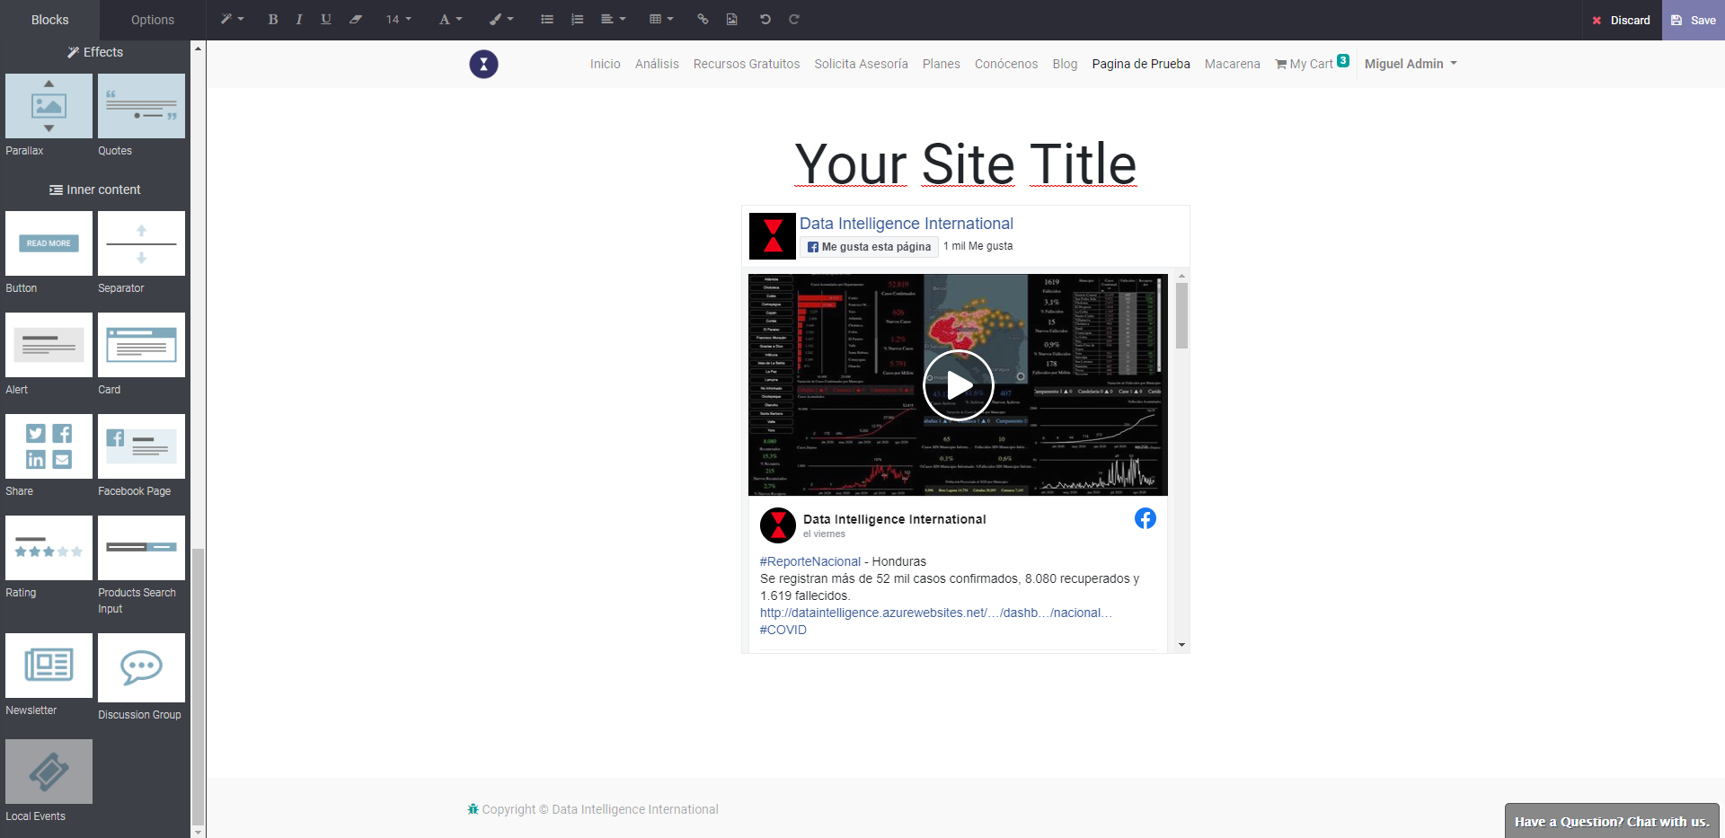
FACEBOOK PAGE

Slide 34
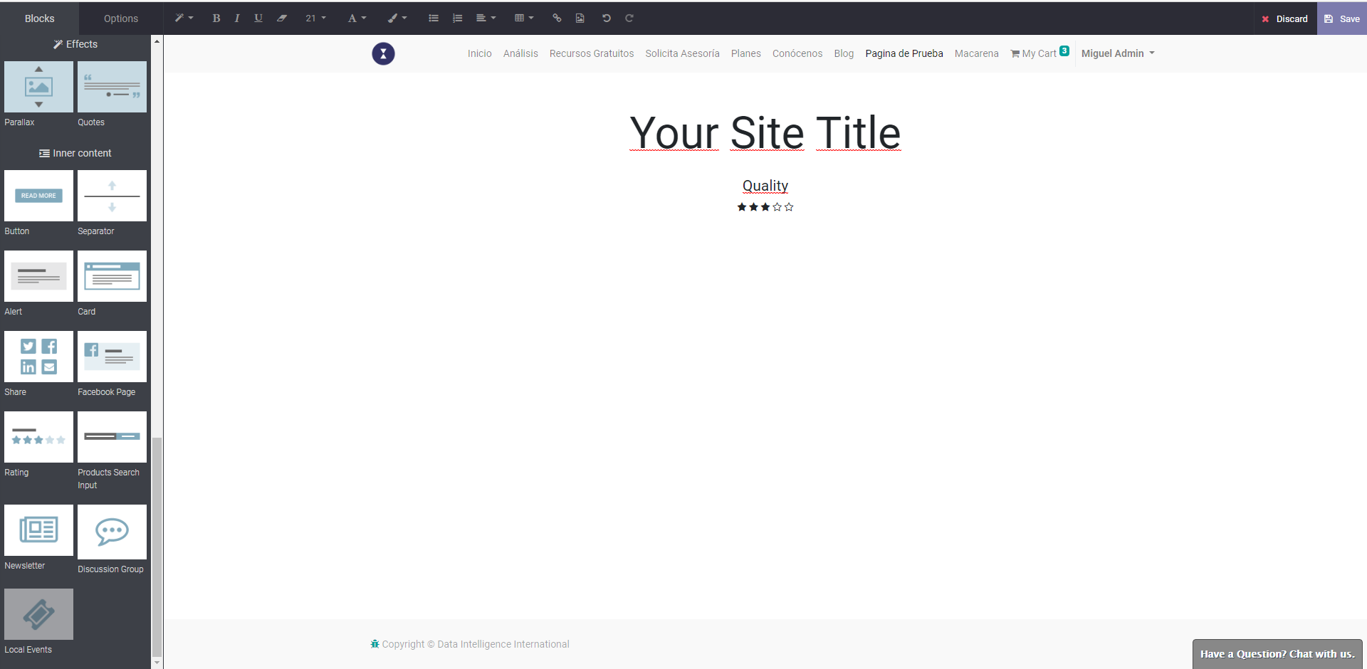
RATING

Slide 35
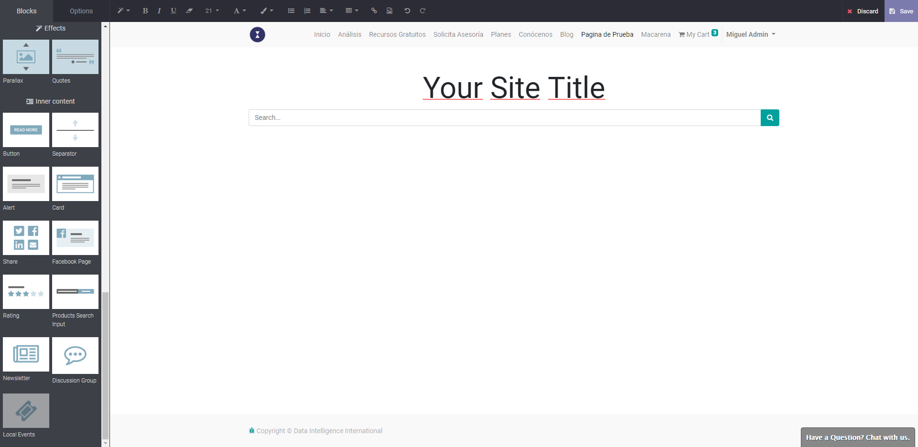
PRODUCTS SEARCH INPUT

Slide 36
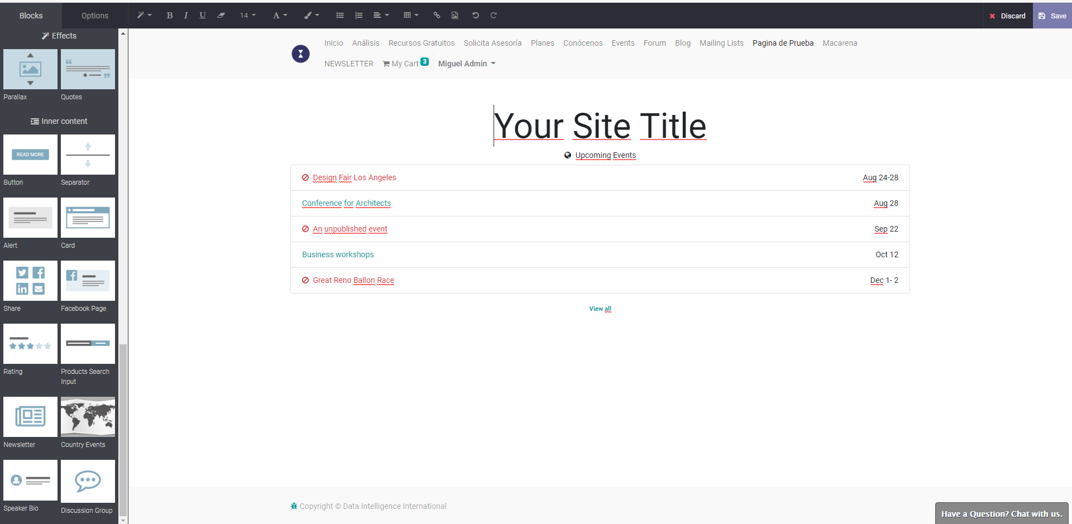
COUNTRY EVENTS

Slide 37
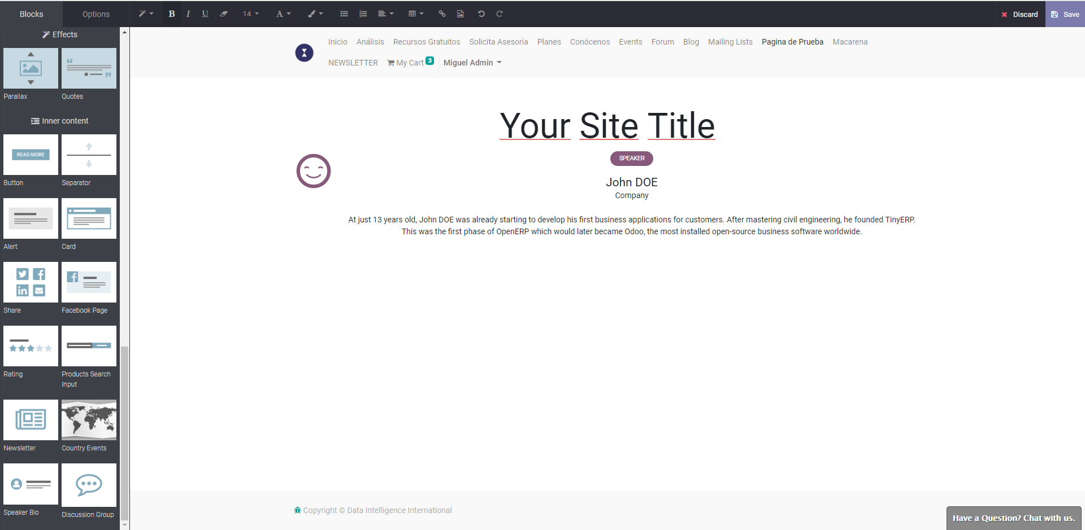
SPEAKER BLO

Slide 38
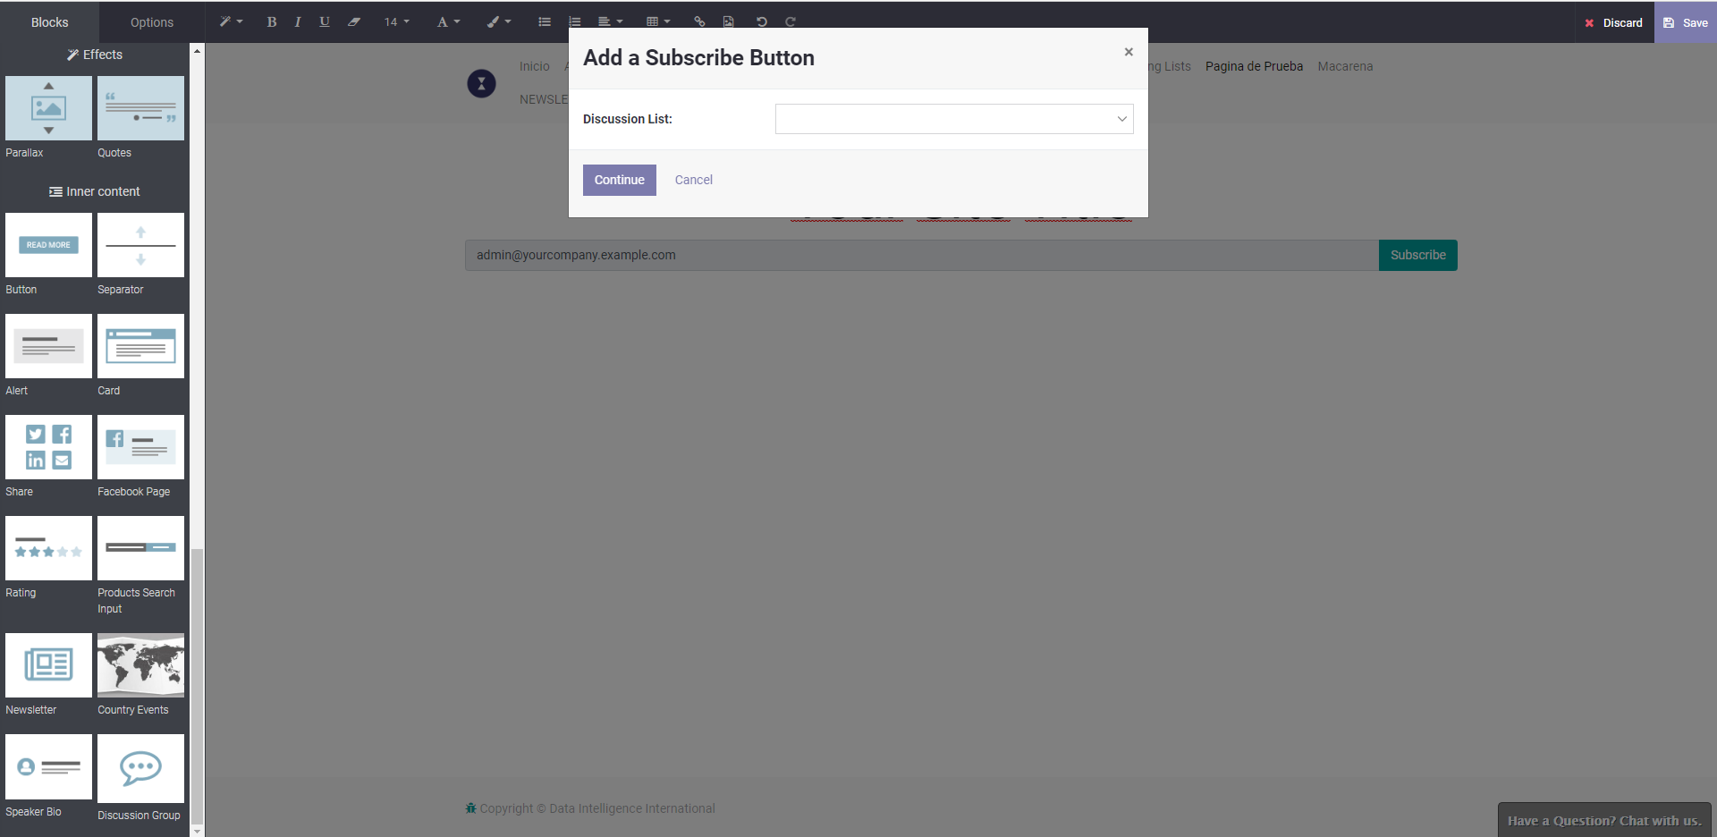
DISCUSSION GROUP

